Slide 1
Fingerprint minutiae extraction
Group no. 10

Slide 2

Why fingerprint?

Slide 3

Fingerprints are the most widely used identification and security solution because of these reasons:
No two fingerprints are exact same.
Do not change with age or disease.
Easy to acquire.
Fast to work with and identify.
Low storage requirements.

Slide 4
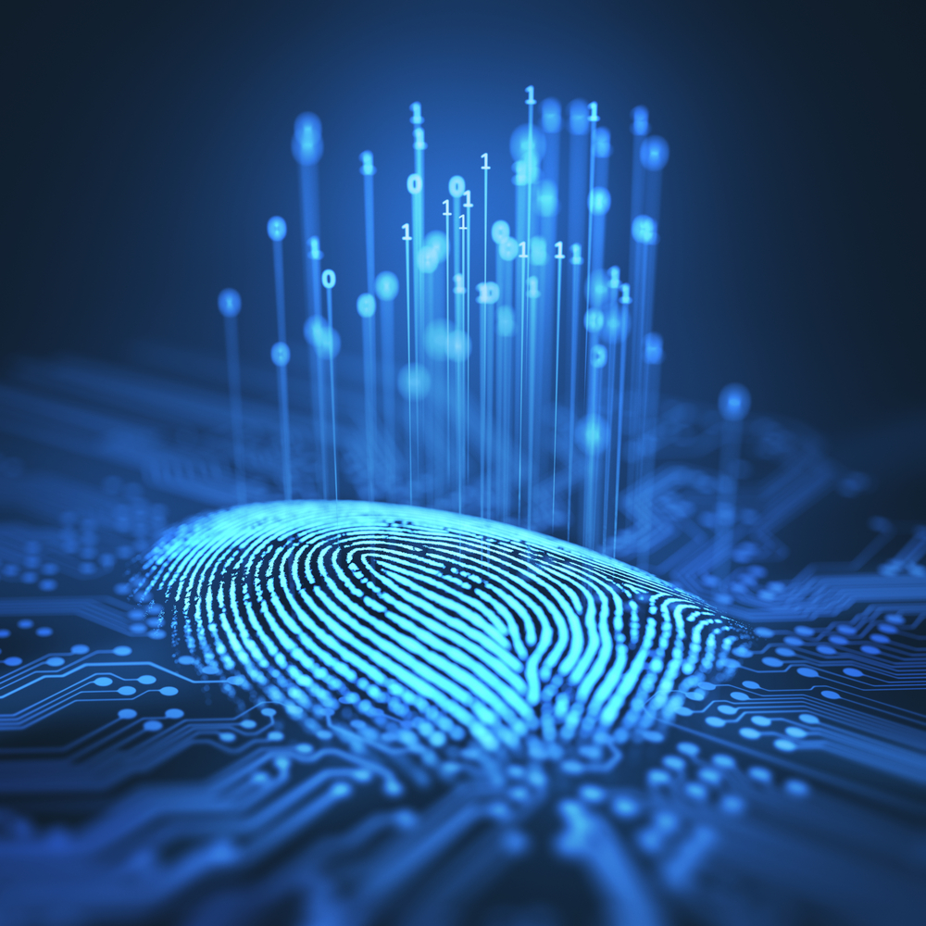
What is it to detect in fingerprint?

Slide 5
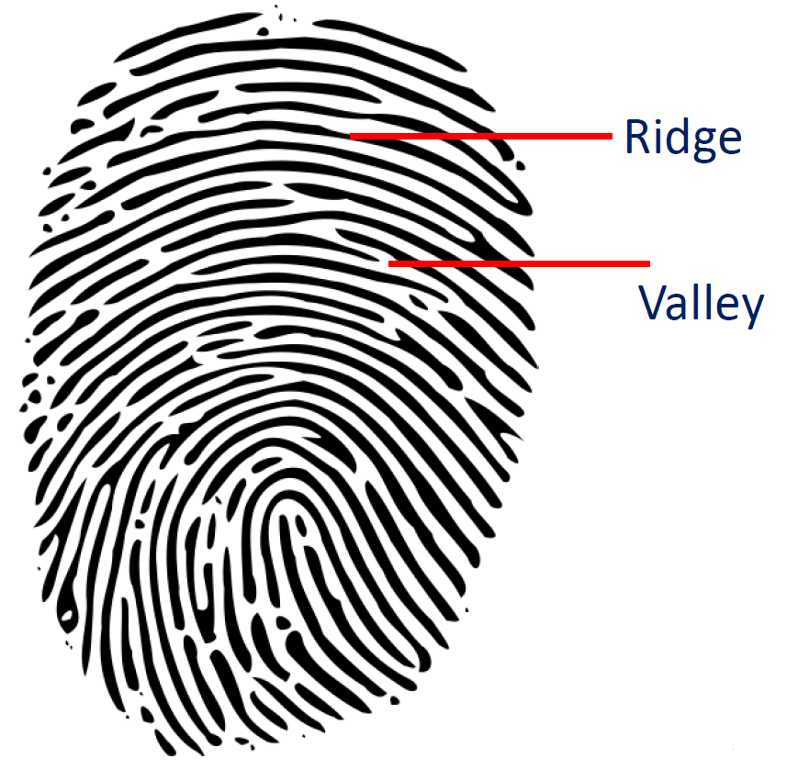
A fingerprint is a distinct pattern of ridges and valleys on the finger surface of an individual. A ridge is defined to be a single curved segment whereas a valley is the area between two adjacent ridges. So, the dark areas of the fingerprint are called ridges and white area that exists between them is known as valleys.

Slide 6
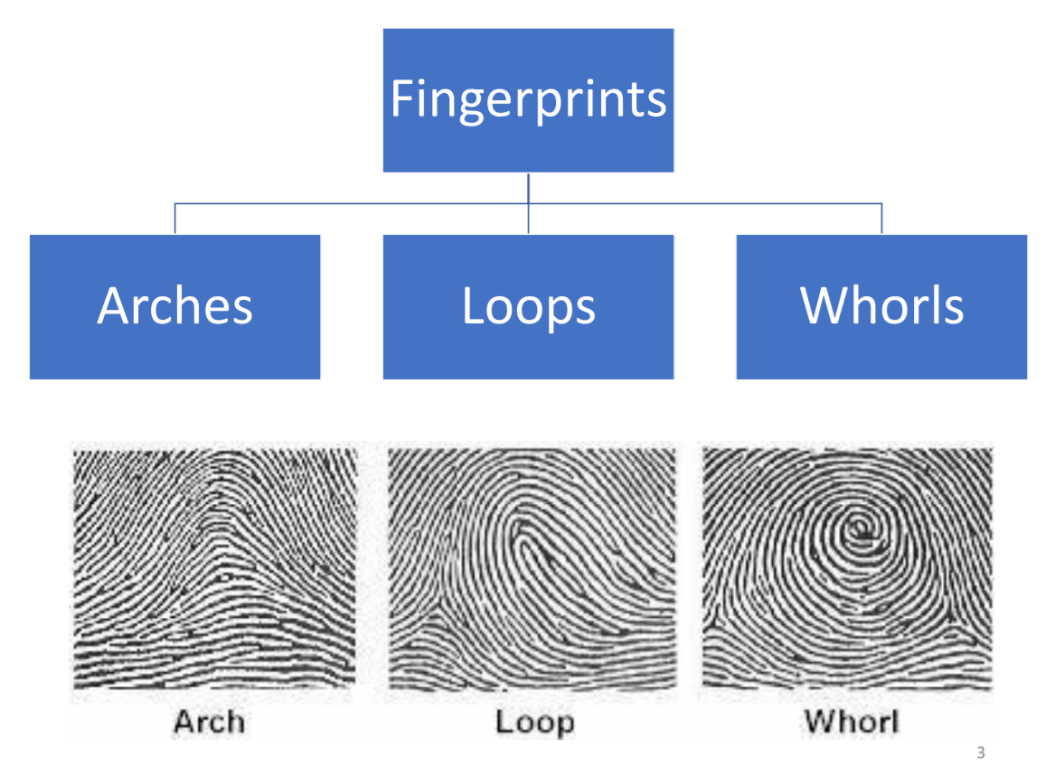
Types of fingerprint patterns

Slide 7
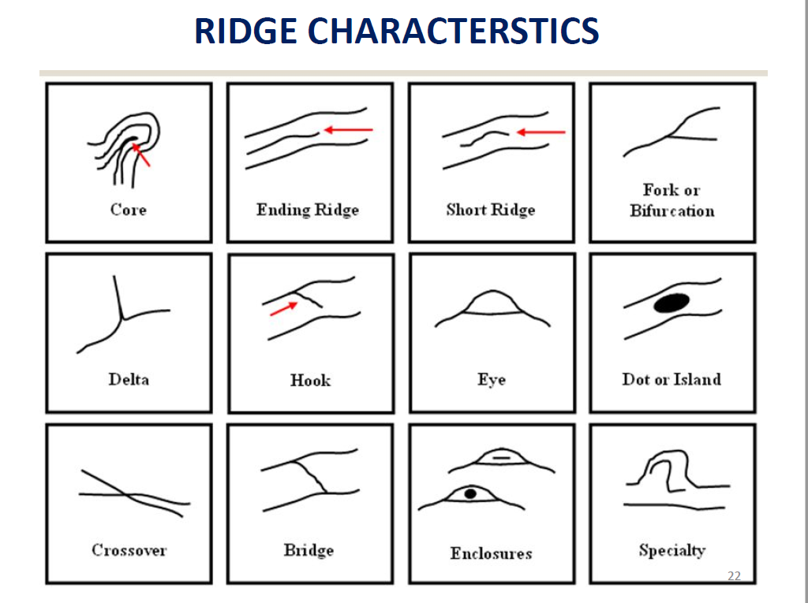

Minutiae can be defined as the points where the ridge lines end or fork. So, the minutiae points are the local ridge discontinuities and can be of many types.
These types are –
Ridge ending is the point where the ridge ends suddenly.
Ridge bifurcation is the point where a single ridge branches out into two or more ridges
Ridge dots are very small ridges.
Islands are slightly longer than dots and occupy a middle space between two diverging ridges.
Ponds or Lakes are the empty space between two diverging ridges.
Spurs is a notch protruding from a ridge.
Bridges are the small ridges that join two longer adjacent ridges.
Crossovers are formed when two ridges cross each other.

Slide 8
Steps involved in minutiae extraction
Image Acquisition
It is the creation of a digitally encoded representation of the visual characteristics of an object, such as a physical scene or the interior structure of an object.
It aims to minimize the undesired effects caused by such elements in order to extract a sufficient number of reliable features or minutiae.
Binarization
It is the process of taking a grayscale image and converting it to binary image.
Image Enhancement
Thinning
Minutiae Extraction
It is a process of extracting a skeleton from an object in a digital image.
Extracting the features of fingerprint called as minutiae.

Slide 9
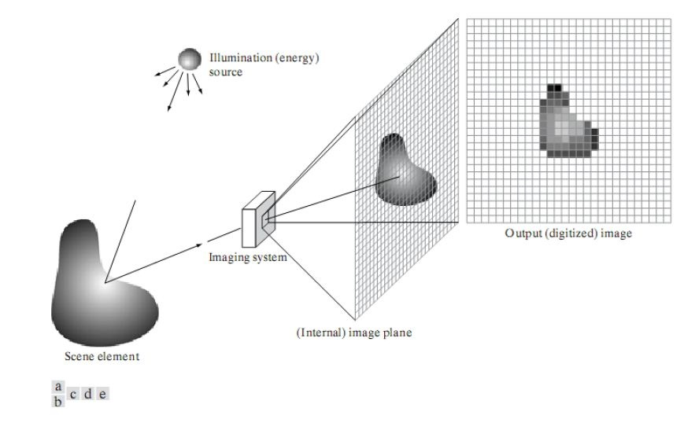
Image Acquisition
It is defined as the action of retrieving the image from a hardware based source usually.
The incoming energy is transformed into a voltage by the combination of input electrical power and sensor material that is responsive to a particular type of energy being detected. The output voltage waveform is the response of the sensor.

Slide 10
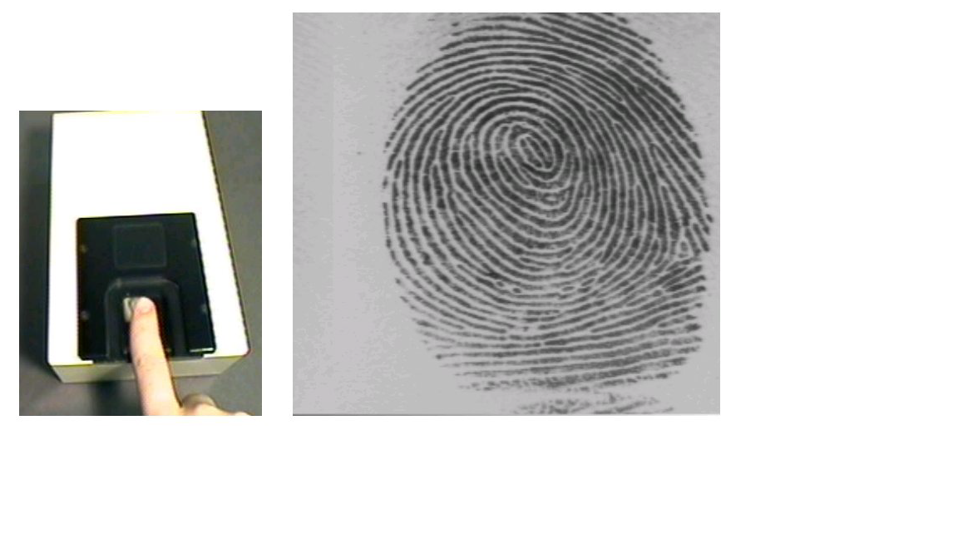
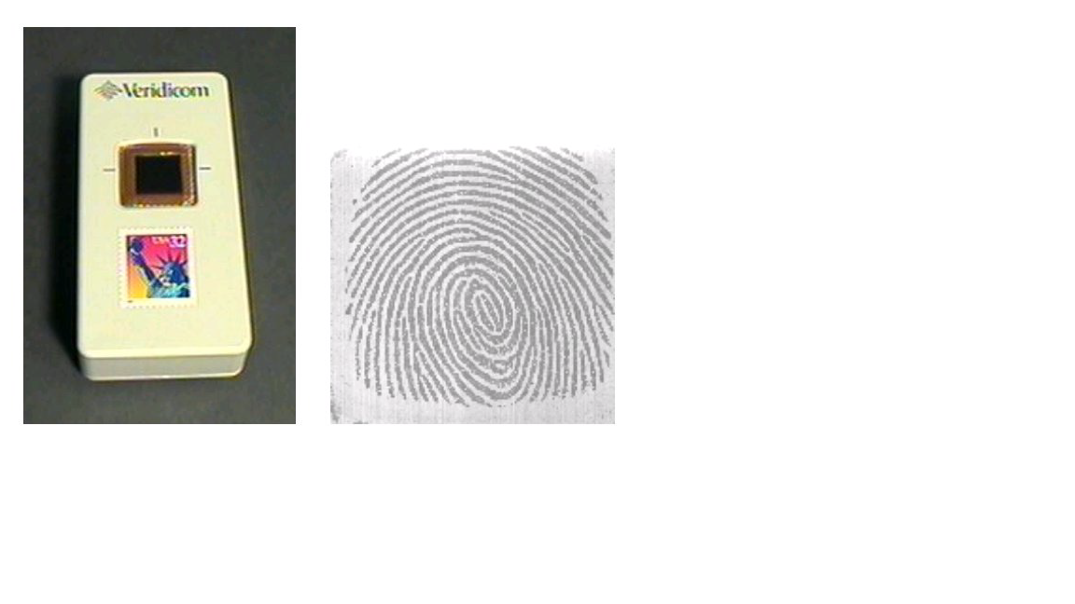
Sensors used for Image Acquisition
Optical sensor
Solid state sensor
1. Optical sensor works on the principle of frustrated total internal reflection. The glass platen is illuminated by LED light. When a finger is placed on the glass plate light falling on the ridges is reflected and is captured by CCD array.
2. Solid-state Sensor
i. Capacitive: It captures the fingerprint image by voltage measurement between an array of capacitors and the fingerprint ridges
.ii. Pressure sensitive: It is made of piezoelectric material and the pressure difference between ridges and furrows is converted into an electrical signal.
iii. Temperature sensitive: It converts the temperature differential between the ridges which touch the surface and furrows which are above the surface into electrical signal.
Frustrated TIR occurs when a third medium with a higher refractive index than the second is brought extremely close to the boundary between the first and second mediums.

Slide 11
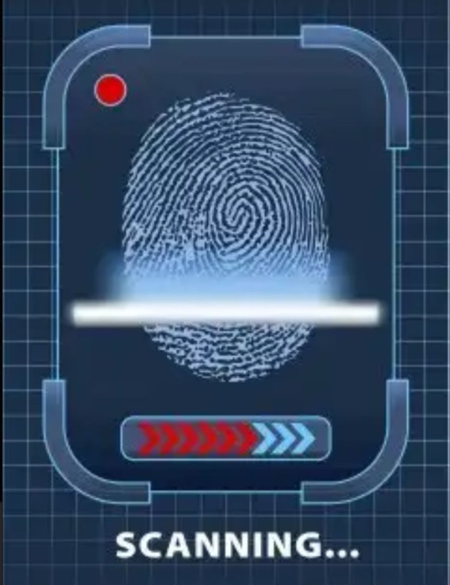
Fingerprint Scanning
The sensor array is coincident with the focal plane, it produces an output proportional to the integral of light received at each sensor.
This image is then digitized using sampling and quantization. The output is a digital image.

Slide 12
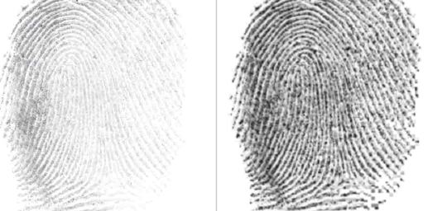
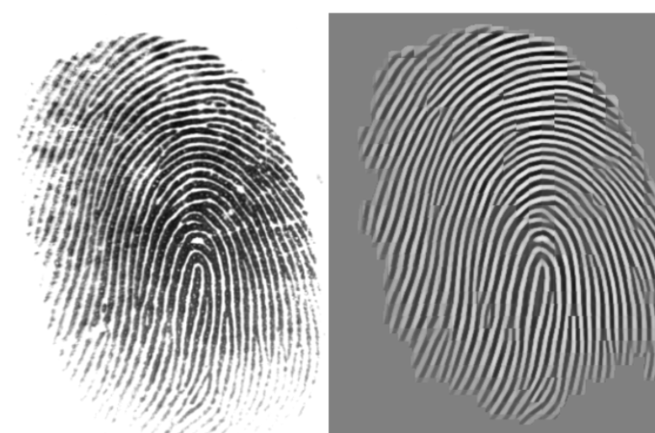
Image Enhancement
Fingerprint image enhancement is the process of applying techniques to reduce noise and to emphasize fingerprint image in order to increase perceptibility and facilitate the identification of ridge valley structures and hence their features.
It generally deals with two major problems – contrast and noise.
Contrast correction: It can be achieved by using histogram equalization technique.
Noise removal: It can be achieved by using various filtering methods such as Median filtering or Wiener filtering.
Contrast correction
Noise removal

Slide 13
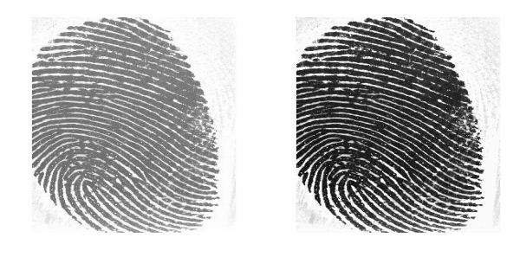
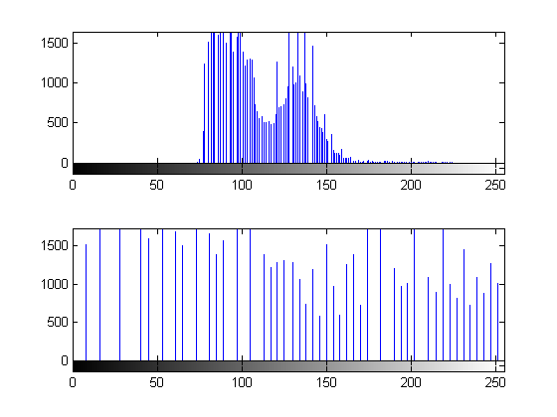
1. Contrast Correction
Histogram Equalization
Intensity distribution
Using Histogram Equalization Technique.
Image intensity is adjusted.
Intensity is distributed on the histogram.
Spread of most frequent intensity value.
Mathematically,
Ps(s) = Pr(r)[dr/ds]

Slide 14
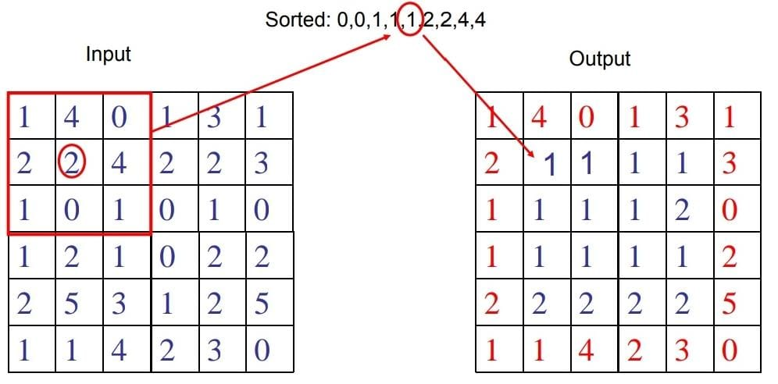
2. Noise Removal
Noise removal using Median filter.
Using Median filter or Wiener filter.
Median filter:
Effective for Salt and Pepper noise.
Works by moving pixel by pixel using window.
Wiener filter:
For removing blur in image.
Assumption: signal and (additive) noise are stationary linear stochastic process with known spectral characteristics or known autocorrelation and cross-correlation.
Requirement: the filter must be physically realizable/causal (this requirement can be dropped, resulting in a non-causal solution).
Performance criterion: minimum mean square error(MMSE).

Slide 15
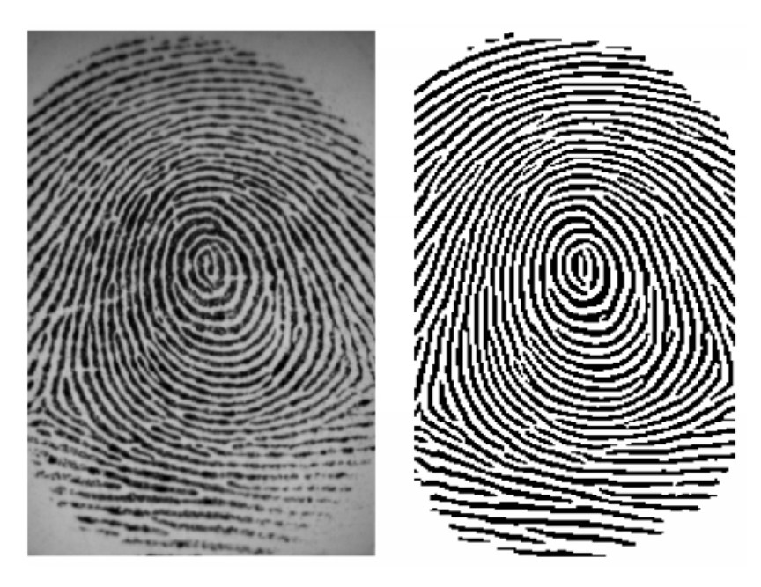
Binarization
Image Binarization is the process of taking a grayscale image and converting it to black-and-white, reducing the information content from 256 shades of gray to 2: black and white, a binary image. This is sometimes known as Image Thresholding.
The aim of this technique is to compare the grey level of each pixel with threshold value to partition an image into foreground and background. If the pixel intensity is larger than threshold value then it is consider as 1 (white pixel) otherwise it is consider as 0 (black pixel).
Otsu method is a clustering based image thresholding. It works when the histogram is bimodal. The method basically tries to minimize the within class variance and at the same time it maximizes the between class variance, thus creating two classes, the background and the foreground.
Binarization

Slide 16
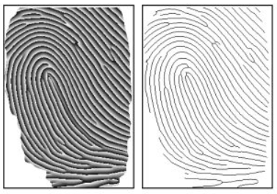
Thinning
Thinning is a morphological operation that is used to remove selected foreground pixels from binary images. It can be used for several applications, but is particularly useful for skeletonization by reducing all lines to single pixel thickness.
Thinning is normally only applied to binary images, and produces another binary image as output. The thinning of an image I by a structuring element J is:
thin (I,J) = I- hit_or_miss (I,J)
where the subtraction is a logical subtraction defined by- X-Y = X Ո NOT Y
The behaviour of a thinning algorithm is determined by its structuring element. Structuring elements are policies which define the situations at which foreground pixels will be set to background and hence deleted.
Thinning

Slide 17
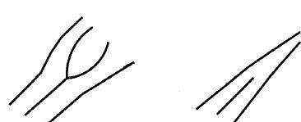
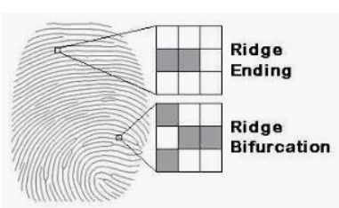
Minutiae Extraction
Most of the fingerprint extraction and matching techniques restrict the set of features to two types of minutiae: ridge endings and ridge bifurcations. A good quality fingerprint typically contains about 40–100 minutiae.
In a latent or partial fingerprint, the number of minutiae is much less (approximately 20 to 30). More complex fingerprint features can be expressed as a combination of these two basic features. For example, an enclosure can be considered a collection of two bifurcations and a short ridge can be considered a pair of ridge endings.
Ridge Bifurcation
Ridge ending

Slide 18
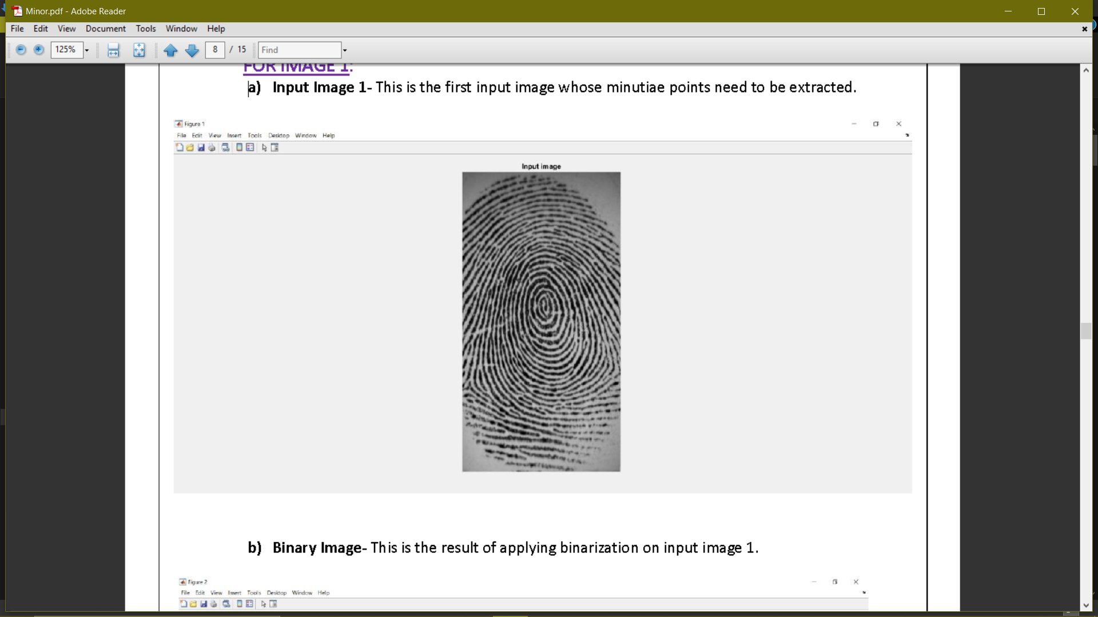
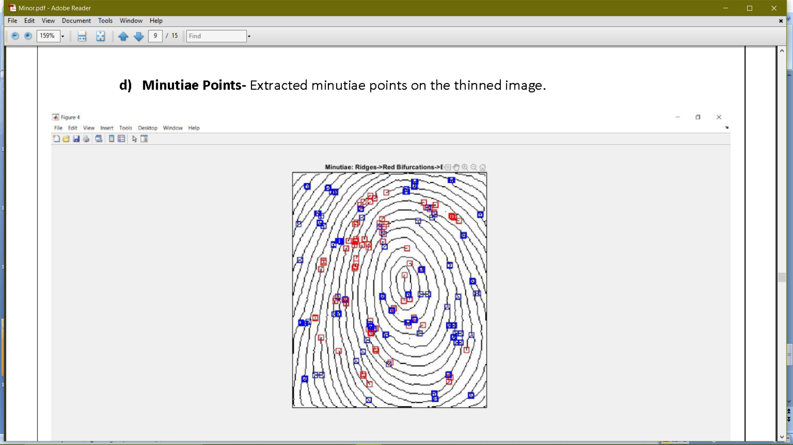
Minutiae extractor result
Ridge bifurcations
Ridge endings
Fingerprint image
Extracted minutiae

Slide 19
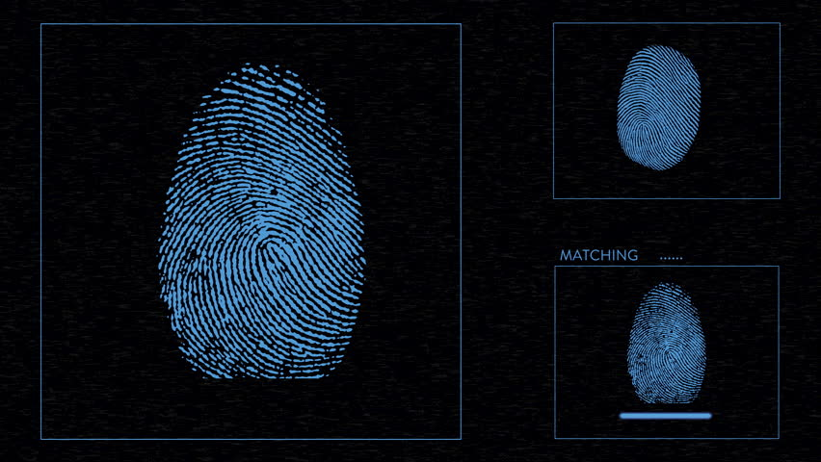
Future scope and advancements
Overall, a set of reliable techniques have implemented for fingerprint image enhancement and minutiae extraction as an efficient minutiae extraction method leads to provide a better platform for matching techniques. These techniques can then be used to facilitate further study of the statistics of fingerprints.
The fingerprints still contain a few spurious Minutiae, especially in the high-curvature regions. To overcome this problem, a better model for the continuous phase of fingerprints of any pattern type should be developed. To obtain reconstructed fingerprint that are even more consistent with the original fingerprints, ridge frequency and minutiae type should be utilized.
The future scope of the work is to match the extracted minutiae from the fingerprint by removal of false minutiae, which may get extracted due to the low quality of fingerprint, in order to uniquely identify an individual. Also, to improve the quality of the image either by improving the hardware to capture the image or by improving the image enhancement techniques so that the input image to the thinning stage could be made better which can improve the future stages and the final outcome.

Slide 20
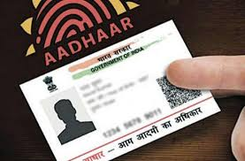
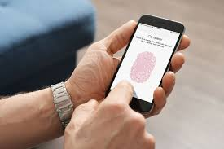
applications
The fingerprint is the most important factor for authentication and authorization. The use of UID (User Identification) to test fingerprints at different places with different applications can make it feasible to examine the originality of the person presented. The applications involve:
National ID systems
Banking security
Information system security
Physical access control (e.g. at airports)
Identification of criminals

Slide 21
